Slide 1
What Physical Skills Have Most Children Mastered at Different Ages?
This section will help staff :
Recognise usual patterns of physical development in terms of gross and fine motor, and hand skills at different ages

Slide 2
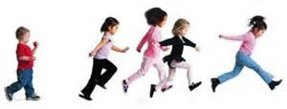
Introduction
Most children will show the patterns of development described in subsequent pages.
Please note that not all children develop at the same pace and it is typical for different skills to emerge at slightly different times for different children.
For more information on those who do not follow typical patterns of development, and who do not significantly demonstrate the outlined skills, view the How does it look if children do not meet their motor milestones resource.

Slide 3
0-1 Months
A child may have a tight fisted grasp with thumb in their palm.
Their hands may open reflexively, and will grasp objects when put into the hand .
The baby will open and close hands in response to stimulus, and will grasp very tight at the little finger side of hand (ulna).
There will be no visual attention to hands (they wont look at what they are doing with their hands).
1-4 months – There may be a continued reflexive use of hands but they will likely start to develop a palmer grasp. There may be a continued strong ulna grasp, arms will move symmetrically, and they will start to reach for objects. They may start to visually attend to hands when in midline, and will hold hands together.
4-6 months – There may be some weight bearing through arms, and some reducing grasp reflex. They may bring hands into midline, will reach and grasp, and use two hands to grasp

Slide 4
1-4 Months
There may be a continued reflexive use of hands but they will likely start to develop a palmer grasp.
There may be a continued strong ulna grasp,
Their arms will move symmetrically and they will start to reach for objects.
They may start to look at/pay attention to their hands when they are in the midline (in front and inline with the middle of their body)
Will hold hands together

Slide 5
4-6 Months
There may be some weight bearing through arms
They their reflex to grasp items might be reducing
They may bring their hands into midline
Will reach and grasp, and
Use two hands to grasp

Slide 6
6-9 Months
They may use mouthing
Bringing objects to mouth
Will make raking movements with hands
Visually monitor objects in their hands
They may point fingers to poke objects
A pincer grasp will emerge, and scissor grasp when holding some thing e.g. string.
They may pass objects between hands, turn objects to look at them, and have grasp strength in index finger side

Slide 7
9-12 Months
They may vary grasp patterns with different objects
A tripod grasp and neat pincer grasp may emerge
They may be able to inhibit little and ring finger for fine grasps
Show bilateral skills (using both sides of their body) as they may hold with one hand and manipulate objects with the other
They may show voluntary release of objects
They may become more independent in feeding and play

Slide 8
Between 1 and 2 Years Old
At this age, children may become functionally more independent e.g. at feeding and play
12-18 months – Children may be able to oppose thumb and finger, turn hands up and down, clap hands together, and use a crayon fisted grasp then digital probate grasp.
They may be able to build a tower of 2 – 3 blocks with their thumb and fingers with good control, they may pour, pull apart Duplo, throw balls, and show bilateral hand use.
18 month to 2 years – They may develop a tripod grasp, turn pages, and show hand dominance.
They may be able to relate objects to one another e.g. use shape sorters, use spoons, produce vertical strokes using crayon, and unwrap things. They may use a fine pincer grasp to pick up objects and release.

Slide 9
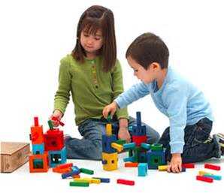
2-3 Years Old
At this age, children may become functionally more independent e.g. at feeding and play
They can pushes and pulls, may be able to wiggle thumbs, and bilateral skills are good.
In hand manipulation of objects may be emerging, hand preference may be evident, and they can fold paper, snip with scissors, and may have a good tripod grasp.
They may be able to imitate a line, cross and circle with a pencil, be able to unbutton, undo a lid, and string beads.

Slide 10
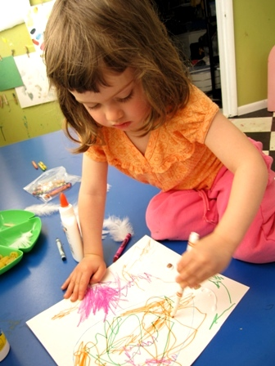
At 3 or 4 Years Old
By this age, a child should:
Have the ability to use both hands together
Their pencil control should be increasing
Have increased strength in grasps
Be able to recognise some objects without vision
Have enough motor control to, walk, run, jump, hop, mobilise on stairs, climb, ride a tricycle and engage in ball games.
Be able to look at shapes and recognise what they are, match them, and copy them.
Be able to produce a circle, straight lines, horizontal lines, and crosses (visual motor integration skills)
Be able to feed themselves using cutlery , do large buttons, cut a straight line with scissors, and use a key and lock,

Slide 11
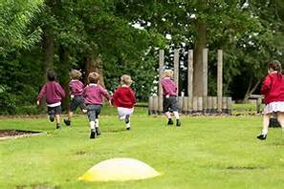
At 5 Years Old
By this age, a child should:
Be able to skip, tip toe walk, have rhythm with movement, and coordinate movements on large play equipment
Show hand dominance e.g. when doing the above
Hold a fork using their fingers, feed themselves soup with little or no spilling, fold paper in half, making sure the edges meet, and put a key in a lock and open it

Slide 12
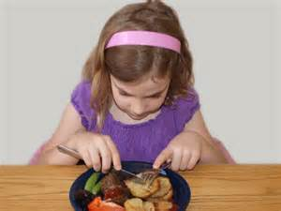
At 6 Years Old:
By this age, a child should:
Be able to fully and independently dress including organising clothes, using buttons, tying bows and completing the task.
Dressing requires the ability to know one’s position in space, body awareness, tone, organisational skills, hand grasps, sensory awareness and so on. It is a complex developmental process moving from gross to refined movement patterns
The use of arm and shoulder decreases with increased use of wrist and fine finger skills. Children should be able to use a knife and fork, be able to colour within lines, be able to copy crosses/diagonals, and be able to cut a square

Slide 13
At 7 Years Old:
At this age a child should:
Be developing very refined motor skills – learning to ride a bike, writing using cursive script albeit large letters but clear, developing spelling skills.
Children will continue to challenge their abilities and there is a social change – the child will become more independent socially wanting to fit into groups and have close friendships.
Children of this age should have adequate concentration to learn for specified periods of time – however movement is still required to maintain a balance of arousal

Slide 14
8 years and above
At this age a child should:
Be ready to move on to more academic learning activities
This because the skills they require to complete tasks are laid down and they have the ability to self regulate arousal levels
Movement is still an important part of development although the core skills are there to be generalised into more complex activities
Development takes a slightly different path – children will continue to push themselves using physical skills but their cognitive abilities start to really take over

